Slide 1


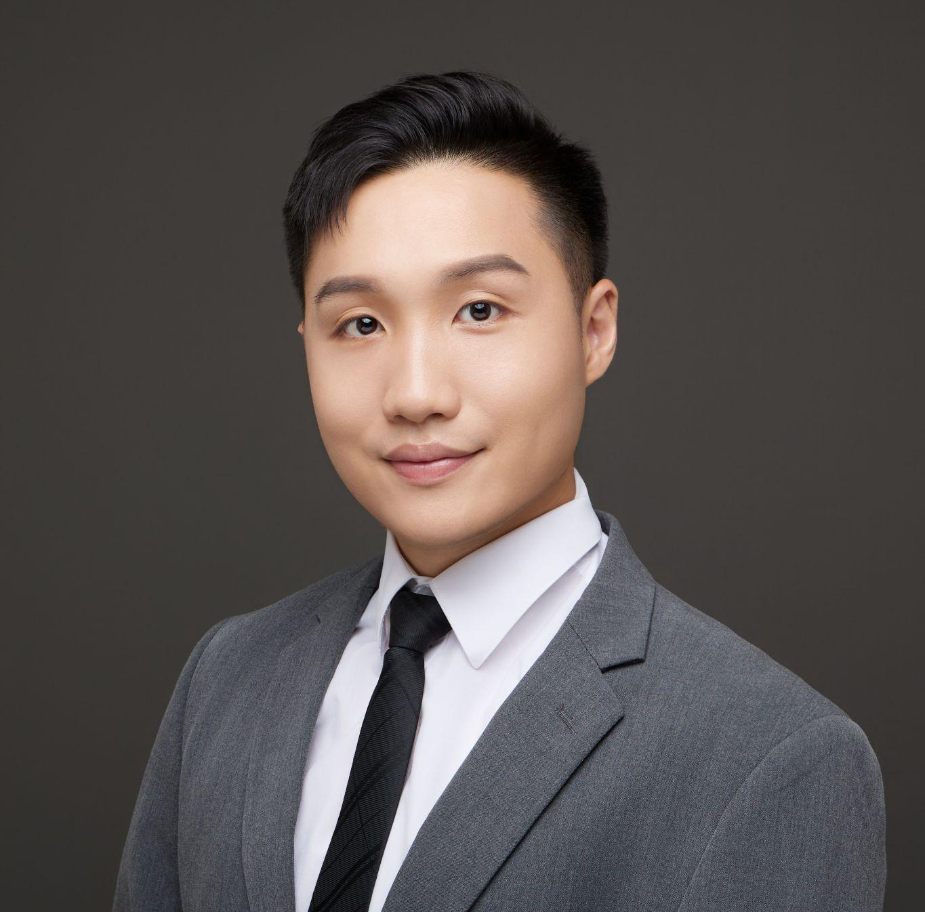

Restaurant AI
Checkpoint 3
Mubtasim Raad
Takumi Nishi
Growing interest in local entrepreneurship—especially in high-risk sectors like restaurants—combined with limited guidance leads to costly mistakes, but AI can integrate market analysis, financial modeling, and compliance checks to reduce risk and lower barriers to entry.
Alex Chen
Laura Shih
https://github.com/IS492-SP26/Restaurants-AI/tree/main
web app: https://restaurants-ai-48ke.vercel.app/
2026/03/06
Notes:
Restaurant AI, a an multi agentic system dedicated to helping first time entrepreneurs successful launch their restaurant business.

Slide 2
Final Problem Statment
Problem statements
How restaurant AI address them
Starting a restaurant or local business is overwhelming for first-time entrepreneurs.
It’s challenging to navigate market validation, financial planning, compliance, and operational risks.
The information current AI tools generate are often without structured guidance and verification.
Users are able to personalize and customize the entire business planning process from minimal inputs.
Users are able to obtain a comprehensive business plan across marketing, financial, regulatory, and operational analysis with multi-agentic workflow.
The restaurant AI tools provide users feasible business plans with regulatory and compliance verification.
Multi-agentic workflow with an “All in One” interface.

Slide 3
Final Problem Statement
Problem Statements
Our AI Solution
• Starting a restaurant or local business is overwhelming for first-time entrepreneurs.
• It’s challenging to navigate market validation, financial planning, compliance, and operational risks.
• The information current AI tools generate are often without structured guidance and verification.
Personalized business planning from minimal inputs.
Comprehensive multi-agentic workflow across marketing, finance, regulation and operations.
Feasible business plans with built-in regulatory and compliance verification.
"All-in-One" interface for seamless navigation.
Notes:
So our problem statement we wanted to work on was to help overcome new and existing restaurant entrepreneurs on the issues of navigating complex information relating to the restaraunt business, including market validation, financial planning and compliance to regulatory standards. And a lot of existing AI tools were insufficient to manage this often due to its lacking structured guidance and verification
Our system is designed as a multi-agentic workflow with a all in one interface system to help address the myriad of issues for new entpreneuers including marketing, finance, regulation, and operations that are personalized to their needs with minimal inputs and generate a feasible business plan with strong regulatory compliance.

Slide 4
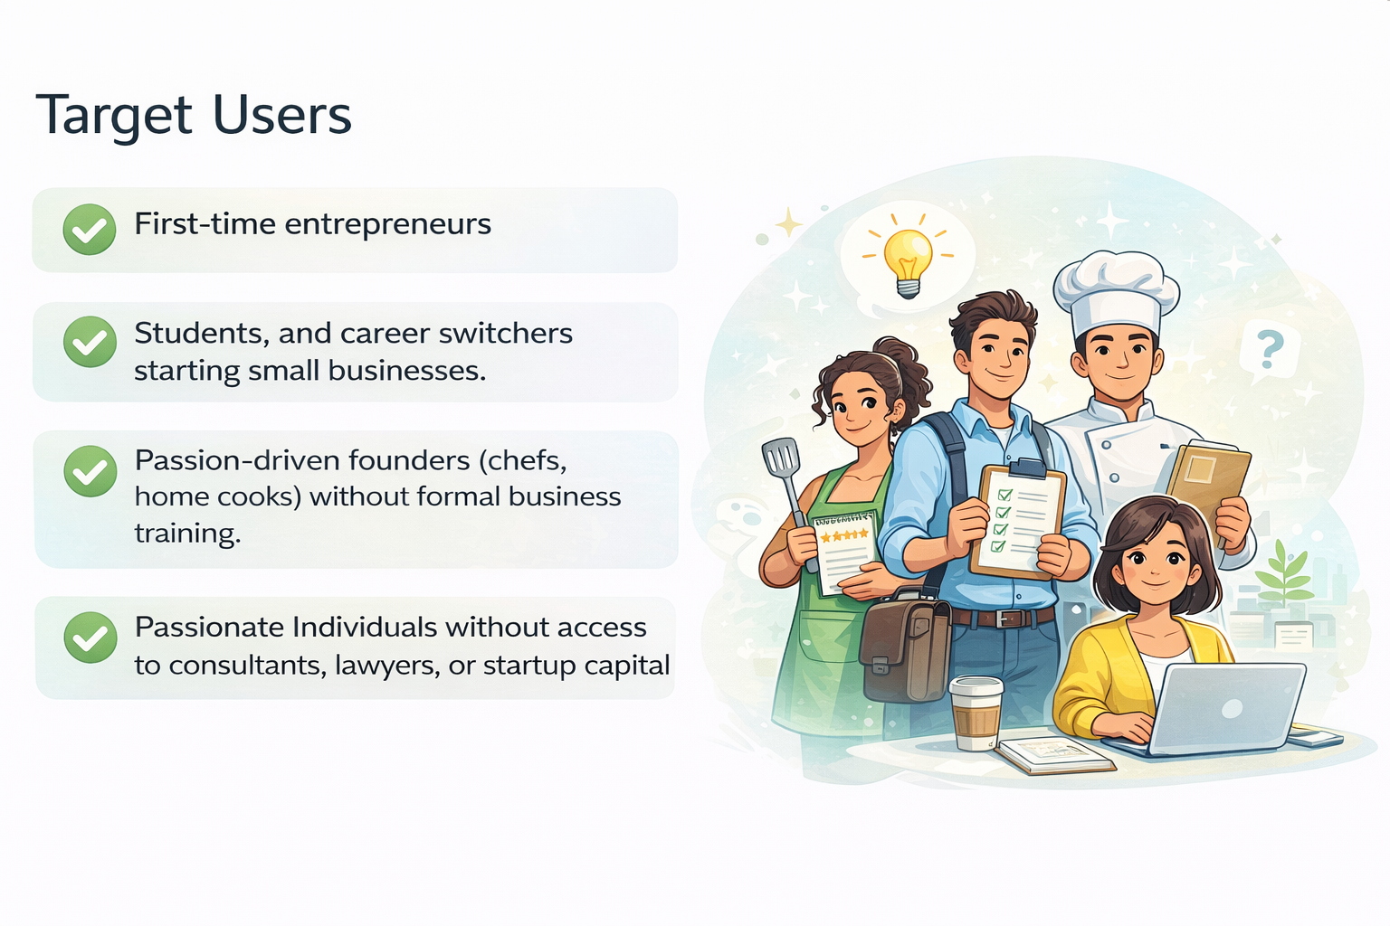
Target User
XXXX
Image generated with ChatGPT (v. 5.2 with Scholar AI
Notes:
Script: Our target users remain the same
people who have strong ideas but limited business experience or resources.
first-time entrepreneurs — individuals who want to start something but don’t know where to begin.
students and career switchers who are exploring small business ideas but lack structured guidance.
We also target passion-driven founders, like chefs or home cooks
Finally, we aim to support individuals who don’t have access to consultants, lawyers, or startup capital.

Slide 5
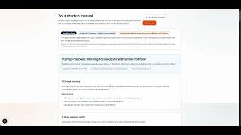
Live Demo
Notes:
Hi everyone, this is our app, Restaurant Startup Studio.
It is designed to help first-time entrepreneurs plan a restaurant business, especially users who may not have much prior experience.
I’ll start from the landing page, the app introduces the idea clearly. The goal is to guide a user from a vague business idea to a more structured restaurant startup plan.
Now I’ll click Start plan.
On this page, the user enters their basic business idea.
For example, I can type:
‘I want to open a restaurant on Green Street near UIUC in Champaign, Illinois. I prefer low risk and fast profit.’
Then the user selects a budget range.
They can also add optional details like cuisine ideas, target customers, or business goals.
This makes the app more flexible, because some users may only have a rough concept, while others may already know more specifics.
Now I’ll submit this form.
At this stage, the app generates three restaurant concept suggestions.
These are based on the founder’s input, budget, and local context.
The purpose here is to help the user compare realistic directions instead of jumping into one idea too early.
For example, the app may suggest different restaurant styles with different customer focus, and operating logic.
The user can read through them and choose the one they think is the best fit.
Now I’ll select one concept and generate the manual.
This is the final output: a restaurant startup guide.
The guide is structured into different sections such as:
financial planning
regulatory or legal requirements
operations
marketing
What makes this app special is that this manual is generated through multiple AI agents, where each agent focuses on one business area.
These agents are grounded in restaurant-related data that we collected, especially data relevant to Champaign, Illinois, so the output is more locally meaningful.
We also built monitoring into the system.
If I go to the Agents page, I can show the status of our fine-tuned AI agents and the model pipeline.
This helps us track whether the system is using fallback logic or fine-tuned models, and it also helps with debugging.
In terms of AI errors and bug handling, we made sure the app can fail safely.
For example:
if the user submits incomplete or invalid input, the API returns a validation error instead of crashing
if saved data is missing between pages, the app shows a recovery message and guides the user back
if a fine-tuned model is not ready or unavailable, the system can fall back to local logic instead of breaking the full workflow
Some bugs we fixed during development included:
cleaning and validating request payloads before generation
fixing issues in the generated financial training data
making the app clearly show when fine-tuned agents are active
adding better monitoring for fine-tune job status
So overall, this app demonstrates how AI can support restaurant entrepreneurs by turning rough business ideas into structured startup guidance through a multi-agent workflow.
Thank you.

Slide 6
Design Decisions & Challenges
Agents | AI Models Used & Why | Data Collected | Challenges
Regulatory (Raad) | Claude, GPT-4o-mini (via OpenAI API). Cost effective at roughly $0.001 per question, Provides better performance. | All public data including: Champaign, IL code of ordinances, food ordinances, zoning ordinance, Illinois food service Sanitation Code, Illinois Food Complinace and Enforcement. | Initially used Groq free tier has rate limits causing errors during heavy testing.
Operations (Alex) | Claude, GPT-4o-mini (via OpenAI API) | Operational data including labor and workflow related data, operational know-how and quality management guidance | Ensuring the model outputs are structured and feasible guidance
Financial (Laura) | Cursor, GPT-4o -mini via OpenAI API, then fine-tuned for financial planning. Chosen because it is fast, lower cost, supports structured JSON, and gives more consistent budget and cash-flow outputs. | Public financial data including CPI-U inflation, Consumer Expenditure Survey income data, FRB H.15 interest rates, Illinois county wage data, BLS weekly earnings, and startup cost worksheet categories. | A key challenge was deciding which financial data is most important to feed into the agent for training, such as inflation, wages, interest rates, consumer spending, and startup cost categories.
Marketing (Takumi) | Claude, GPT-4o-mini (via OpenAI API) | Data relating to marketing strategies (research and branding), Restaurant information (address, type) in Champaign | Structure of output for marketing information
Notes:
Script: Our system uses four specialized agents built on GPT-4o. To kickstart our development, we leveraged Cursor, which generated our core framework and allowed us to rapidly architect a four-agent system. For our agents, we focused on processing high-density local data, like (code of ordinances & sanitation code data) to ensure the advice is legally grounded.
We used a fine-tuned version for its speed and ability to handle structured outputs. We grounded it in public financial data—including inflation, interest rates, and wage trends—to provide realistic planning support.
Our biggest challenge was data prioritization: deciding exactly which economic indicators were vital for an entrepreneur versus just 'noise.' By pivoting from Groq to the OpenAI API, we overcame initial rate-limiting hurdles to deliver a robust, high-performance consulting tool.

Slide 7


Safety, Privacy & Reliability
Data Privacy (No PII)
The application protects privacy by collecting only business-related info. No personal identifying information (PII) or sensitive data is stored.
Regulatory Compliance
Outputs are verifiable, citing real-world sources like CUPHD and FDA Food Codes, allowing users to cross-check guidance.
User Disclaimer
Defined as an educational planning assistant. Users are directed to consult professionals for legal or financial advice.
API Key Security
API keys are excluded from the public Github repo. Credentials are never exposed.
Notes:
For safety and privacy, our AI is designed with four key safeguards.
First, data privacy — we don't collect any PII. The only inputs we ask for are business-related: location, budget, cuisine type, and goals. Nothing sensitive is stored.
Second, regulatory compliance — our Regulatory Agent doesn't just generate advice from scratch. It cites real-world sources like CUPHD Sanitation Rules, City of Champaign zoning codes, and FDA Food Codes, so users can verify the guidance themselves.
Third, we include a clear disclaimer on the interface. It's labeled as an educational planning assistant — not legal, tax, or financial advice. We explicitly direct users to consult professionals before making real decisions.
And finally, API key security — all API keys for OpenAI and Claude are excluded from our public GitHub repo, so credentials are never exposed.

Slide 8

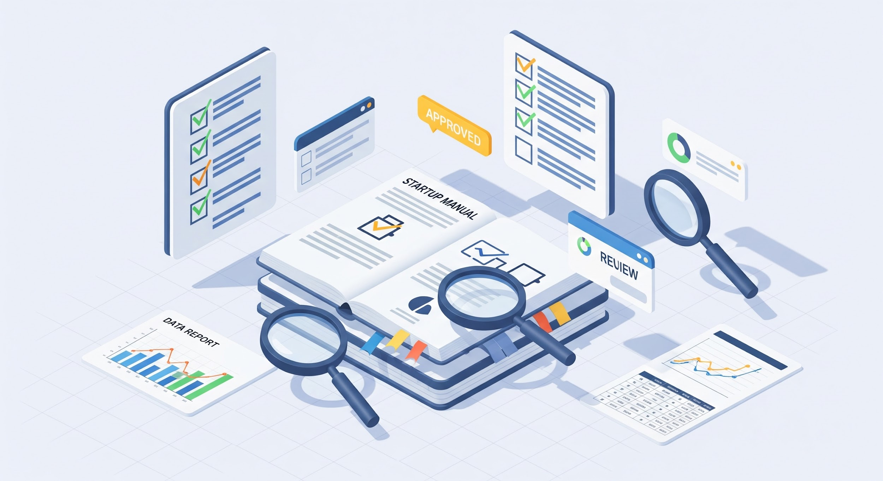

Risks, Safeguards and Next step
Next Milestones for CP4
User testing
Recruit entrepreneurs and students to test the 3-step flow (Basics → Ideas → Manual) and measure completion time, usefulness, and trust.
Evaluate output quality
Assess if generated manuals offer actionable, accurate guidance compared to general-purpose AI tools across various business domains.
Address Hallucination risk
Tackle hallucination risk by implementing confidence scores and verification layers to ensure high reliability of generated content.
Notes:
First, user testing — we'll recruit first-time entrepreneurs and students to walk through our full three-step agentic workflow, and measure completion time, usefulness, and how much they trust the output.
Second, evaluating output quality — we want to assess if our generated results provide more feasible and accurate guidance compared to general AI tools like ChatGPT, across regulatory, financial, marketing, and operations domains.
And third, addressing hallucination risk — Depends on the response from the participants, we may add in confidence scoring mechanism to add extra verification layer to our outputs

